Slide 1


Project I Mid Defense
“SkillQuest – Freelancing Platform for Students”
Prepared By: Rojip Chhantyal
Date: 11 Janurary, 2026

Slide 2
Introduction
SkillQuest is a student-focused freelancing platform
Designed to connect students with local small business
Helps students gain experience and earn while studying
Provides affordable solutions for small business tasks

Slide 3
Problems
No dedicated freelancing platform for students
Global platforms are highly competitive for beginners
High service charges make small tasks costly
Clients struggle to find affordable and trusted students

Slide 4
Objectives
To connect students with clients for small tasks
To provide a simple and student-friendly freelancing system
To help students gain real-world project experience
To support local businesses with affordable services
To provide secure system

Slide 5
Development Methodology
Agile model is used for system development
Development is divided into small modules
Continuous improvement through iterative development
Easy to handle changes in requirements

Slide 6
Functional Requirements
Student ,Business can registration and login
Business can post ,manage, and get student submitted task
Student task browsing ,claim, track and submit the complete task
Admin can manage user ,business and approve the who can register

Slide 7
Non-Functional Requirements
Simple and easy-to-use interface
Scalable for future growth
Fast system performance
Secure data handling
Low system and storage requirements

Slide 8
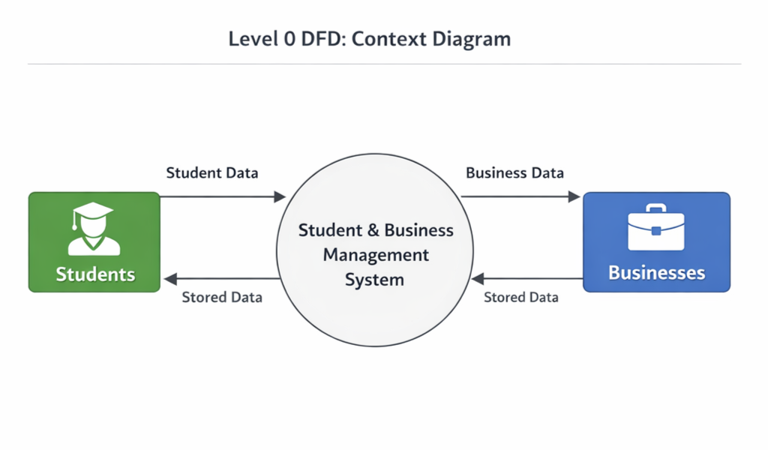
DATA FLOW DIAGRAM (DFD)
Student and business data are stored in the database, processed by the backend, and shown on dashboards and reports.

Slide 9
Implementation
The system is implemented as a web-based application.
Frontend developed using HTML, CSS, and JavaScript
JSP used for dynamic web pages
Servlet handles server-side logic
JDBC and MySQL used for database management

Slide 10
Conclusion
SkillQuest provides a student-focused freelancing solution
Helps students earn and gain practical experience
Supports local clients with affordable services
System can be enhanced with more features in future

